Slide 1
Play Framework
Sarthak Nagpal

Slide 2
Agenda
Introduction
Features of Play
Controllers and routes
Database Support
Integration with Akka
Creating and running a play app
Users
References

Slide 3
Introduction to Play
Play is a high-productivity web application framework launched in 2008 for programming languages whose code is compiled and run on the JVM, mainly Scala and Java. It integrates the components and APIs we need for modern web application development.

Slide 4
Features of Play
Stateless web framework (MVC)
Built for asynchronous programming
Full-stack web framework(includes model persistence, template mechanism, controller and testing)
Aims at being developer-friendly, hot-reload capability, fully compiled and type safe
Datastore and model integration

Slide 5
Threaded vs evented web servers
Thread pool maintains several threads and for each request, a thread is allocated until the request is completed
Thread is occupied but potentially idle due to long running IO requests to services
For evented web servers, thread is occupied only if there is something to do
Play incorporates the concept of work stealing where one thread steals the work of another thread if its free itself
Enables asynchronous, non-blocking server requests/responses

Slide 6
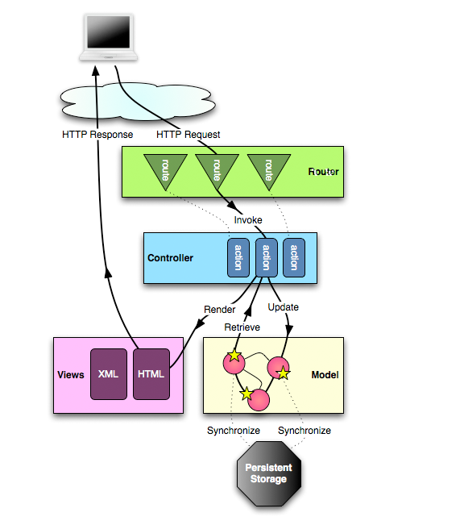
Controllers and routes
HTTP requests are forwarded from the web client to the routes(in conf/routes file)
Example :
GET /clients/:id controllers.Clients.show(id: Long)
These routes will be sent to the appropriate method in the controller file
The method will return an Action value and render the it to the view

Slide 7
Database Support
Play has relational database access libraries such as JPA, Slick and Anorm providing bundling tools to access classic databases
It also has the capability to integrate other DB modules like ‘reactive mongo’ for asynchronous requests/responses.
As play is asynchronous and non-blocking, a separate thread pool and execution context must be created to access the blocking database drivers like JDBC,etc.

Slide 8
Integration with Akka
Play framework is built on akka to process the asynchronous and non-blocking requests
Akka makes it possible to write highly distributed and concurrent systems
Akka actors can be created using the actor system injected via DI (Guice)
For scaling the app, cluster sharding can be introduced to run the app in highly distributed fashion.

Slide 9
Creating and running a Play app
To create a new project :
sbt new playframework/play-scala-seed.g8
After the project is created:
Enter sbt run to start the Play app in dev mode and enter http:localhost:9000/ to view the welcome page. To change the port number , run sbt “run 9001”
To run the app in Production mode ,visit here.

Slide 10
Users
Electronic Arts(EA)
Guardian
Walmart
Verizon
Linkedin
Samsung
Zalando

Slide 11
References
https://www.playframework.com/documentation/2.8.x/Home
https://www.playframework.com/documentation/2.8.x/ScalaRouting
https://www.playframework.com/documentation/2.8.x/AkkaIntegrations

Slide 12
Thank you

